Slide 1

TELECOMMUNICATION CUSTOMER CHURN ANALYSIS REPORT
Presented by : MANMATHNATH MAHANTA

Slide 2
INTRODUCTION
Imagine running a bustling telecommunications company, where thousands of customers rely on your services for their everyday communication needs. One day, you notice a steady stream of customers leaving for competitors. This phenomenon, known as customer churn, can significantly impact your business. Understanding why customers leave and predicting who might leave next is crucial for sustaining your business. Our project delves into the intricacies of customer churn in a telecommunications company, uncovering the hidden patterns and factors that drive customers away. Our ultimate goal is to provide actionable insights that can help retain customers and enhance their satisfaction.

Slide 3
KEY TERMS AND CONCEPTS
Before we dive into the analysis, let's familiarize ourselves with some key terms:
Churn: This is when customers stop using your service. In our dataset, it's recorded as 'Yes' for those who left and 'No' for those who stayed.
Tenure: This represents how long a customer has been with the company. It's a strong indicator of customer loyalty.
Contract: Customers can choose between different contract types such as month-to-month, one year, or two years. The type of contract influences their likelihood of staying.
Internet Service: The type of internet service (DSL, Fiber optic, or no internet) affects customer satisfaction and, consequently, their decision to stay or leave.
Payment Method: How customers pay their bills (electronic check, mailed check, bank transfer, credit card) can also impact their satisfaction and loyalty.
Partner and Dependents: Whether customers have a partner or dependents can influence their churn decisions.

Slide 4
OBJECTIVES
Aim of the Analysis :
Investigate customer churn using a comprehensive telecommunications dataset.
Identify key factors influencing churn.
Develop a predictive model to pinpoint likely churners.
Offer actionable recommendations to reduce churn and enhance customer satisfaction.

Slide 5
DATASET OVERVIEW
Imagine sifting through a vast dataset containing information about 7043 customers. Picture each row as a story of an individual customer, complete with their service preferences, payment habits, and personal details. As we explore these stories, certain patterns begin to emerge.
Total Customers: Envision a bustling city of 7043 individuals, each with unique preferences and behaviours.
Average Monthly Charges: Picture a typical customer paying ₹ 64.76 each month, a crucial detail in understanding their satisfaction levels.
Churn Rate: Out of the entire customer base, approximately 26.54% have decided to leave, highlighting a significant challenge for the company.
Retained Customers: Despite the churn, 5174 customers have chosen to stay, presenting an opportunity to build stronger relationships.
Churned Customers: 1869 customers have left, each carrying a unique reason for their departure.

Slide 6
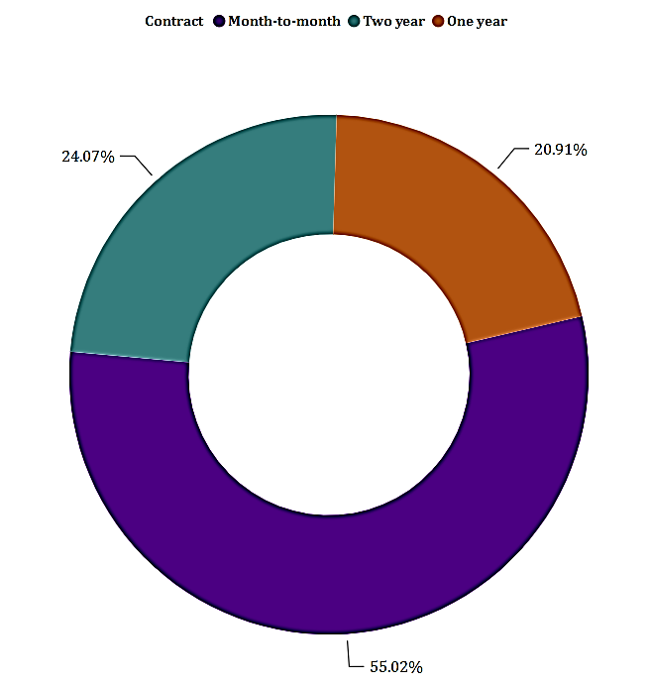
ANALYSIS
Contract Distribution
Imagine a marketplace where customers choose different types of contracts based on their needs:
Month-to-month contracts: Over half of the customers (55.02%) prefer the flexibility of month-to-month contracts. However, this flexibility often translates into a higher likelihood of leaving.
One-year contracts: About one-fifth (20.91%) opt for the stability of a one-year contract, showing a moderate level of commitment.
Two-year contracts: Another 24.07% of customers commit to two-year contracts, indicating a stronger loyalty to the company. Contract Distribution

Slide 7
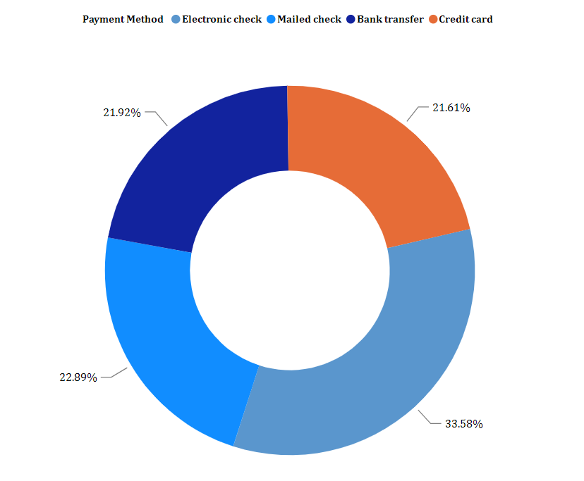
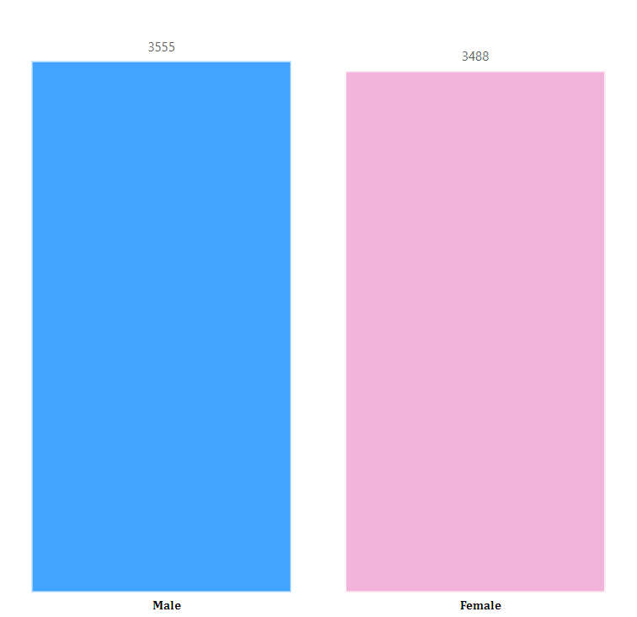
Payment Method Distribution
Consider how customers prefer to handle their payments:
Electronic Check: One-third of the customers (33.58%) use electronic checks, a method associated with higher churn.
Mailed Check: Nearly a quarter (22.89%) still rely on traditional mailed checks.
Bank Transfer and Credit Card: The rest of the customers are almost evenly split between bank transfers (21.92%) and credit card payments (21.61%), both of which are associated with lower churn rates.
Customer Demographics
Imagine the diverse tapestry of customers, each bringing their unique backgrounds and life situations:
Gender Distribution: The customer base is nearly evenly split between males (3555) and females (3488), each group showing different patterns in their behaviour and loyalty.
Senior Citizens: Picture a segment of the population (1142 individuals) as senior citizens, who might have different service needs and expectations compared to the younger majority (5901).
Partners: Consider how having a partner influences customer decisions, with 3402 customers having partners and 3641 without.

Slide 8
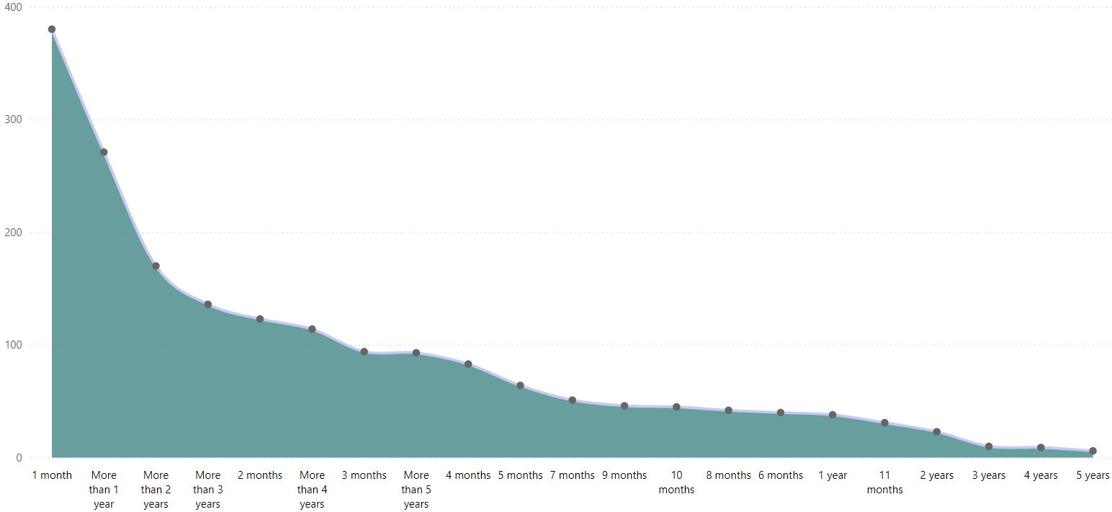
CHURN ANALYSIS
Tenure-wise Churn
Imagine customers embarking on a journey with the company:
Early Stages: In the initial months, many customers (especially those within the first year) seem to evaluate the service critically. If dissatisfied, they are more likely to leave early.
Established Customers: As tenure increases, customers become more integrated and loyal, leading to lower churn rates. This trend suggests that the longer customers stay, the more likely they are to continue their journey with the company.

Slide 9
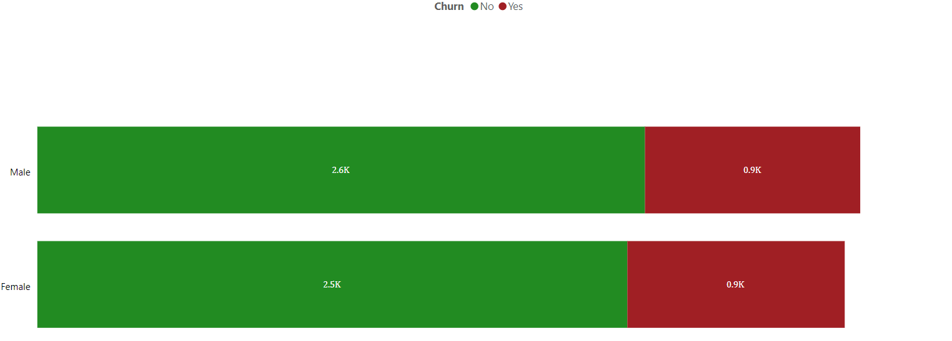
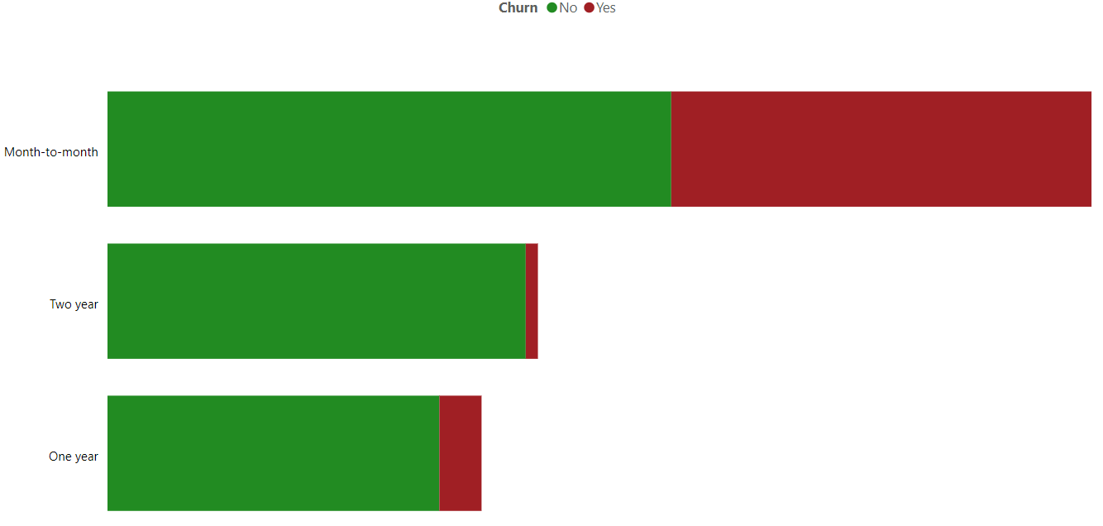
Gender-wise Churn
Envision the nuanced differences between male and female customers:
Male Customers: They exhibit a slightly higher tendency to churn, which could be influenced by various factors such as service expectations and personal preferences.
Female Customers: While their churn rate is slightly lower, understanding their unique needs could help tailor retention strategies more effectively.
Contract-wise Churn
Think about the commitment levels reflected in contract choices:
Month-to-month contracts: These customers, who prioritize flexibility, exhibit the highest churn rates. They are constantly reassessing their options and may leave if dissatisfied.
One-year and Two-year contracts: Customers with longer commitments show more loyalty, with significantly lower churn rates. These contracts provide stability and a sense of ongoing relationship with the company.

Slide 10
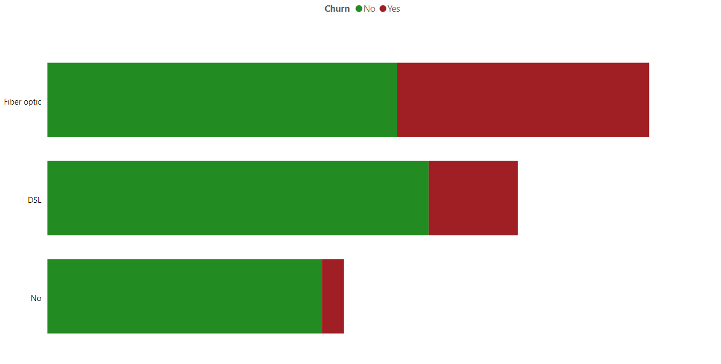
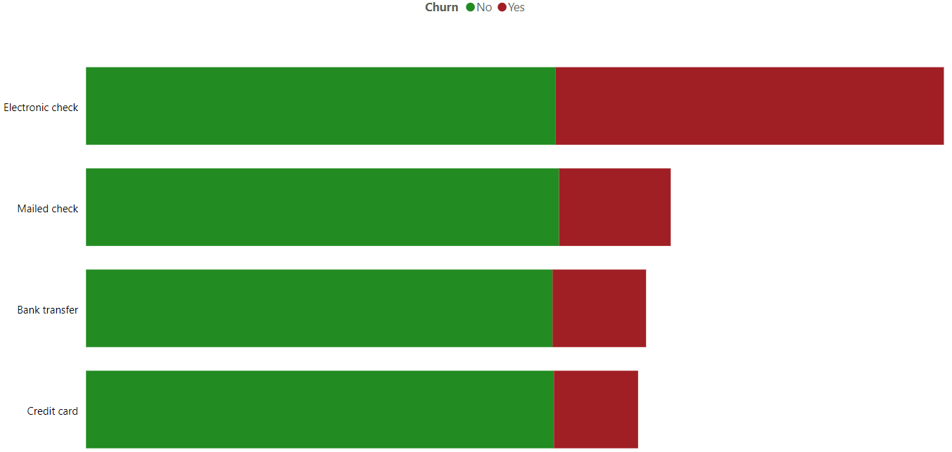
Internet Service-wise Churn
Consider the impact of the type of internet service on customer satisfaction:
Fiber Optic: Despite being a premium service, customers using Fiber Optic tend to churn more, possibly due to unmet expectations or service issues.
DSL and No Internet Service: These customers exhibit lower churn rates, indicating a higher level of satisfaction or fewer available alternatives.
Payment Method-wise Churn
Imagine the different experiences customers have based on their payment methods:
Electronic Check: This group faces the highest churn rate, potentially due to the convenience or inconvenience associated with this payment method.
Credit Card and Bank Transfer: Customers using these methods show greater satisfaction and loyalty, possibly due to the ease and reliability of these payment options.

Slide 11
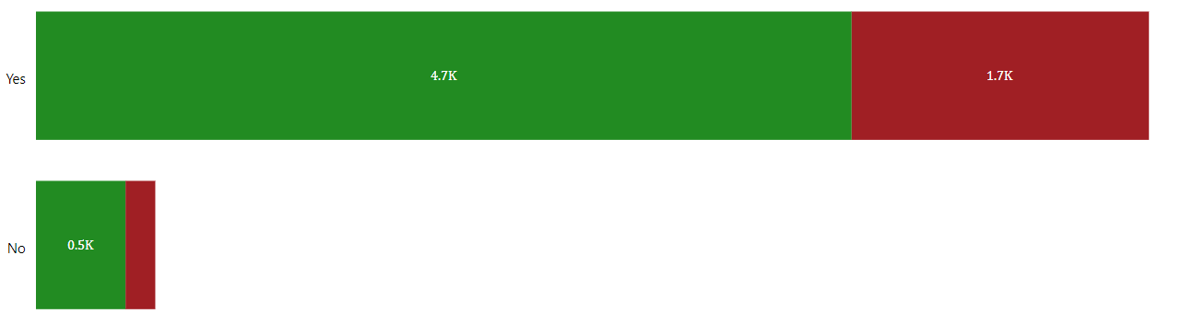
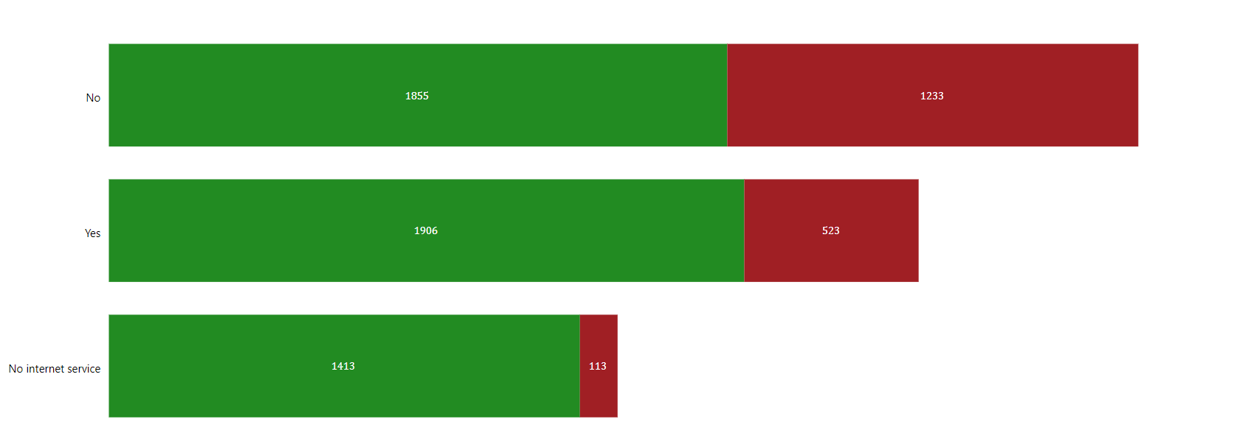
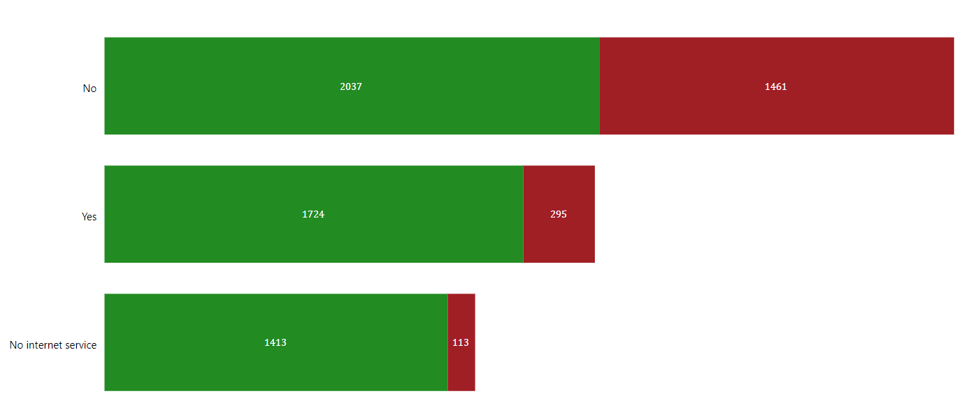
Service Usage and Churn
Picture the varied landscape of service usage among customers:
Phone Service: Customers without phone service tend to churn more, indicating that phone service is a crucial component of customer satisfaction.
Online Backup and Security Services: Those who use these services are less likely to churn, highlighting the value they find in additional security and backup options.
Online Backup Services
Online Security Services

Slide 12
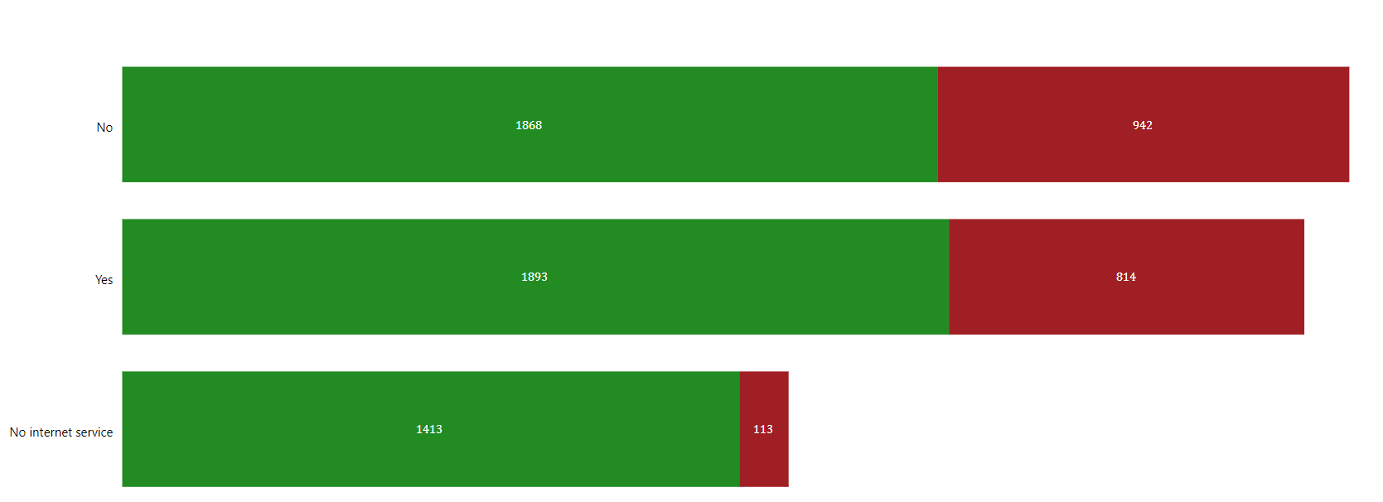
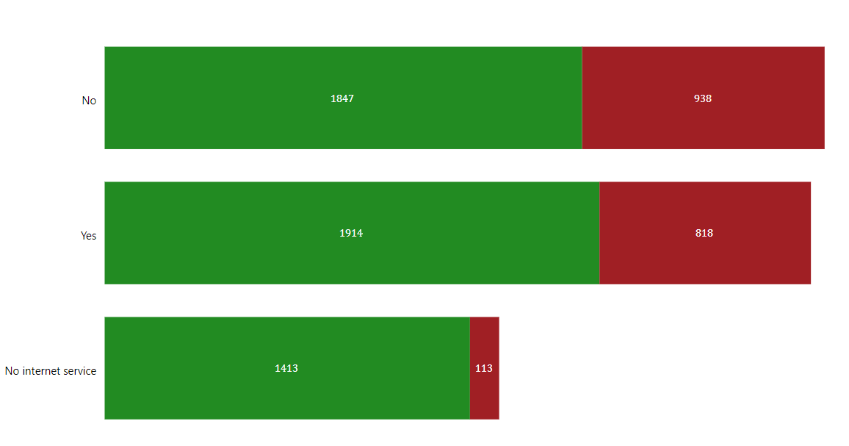
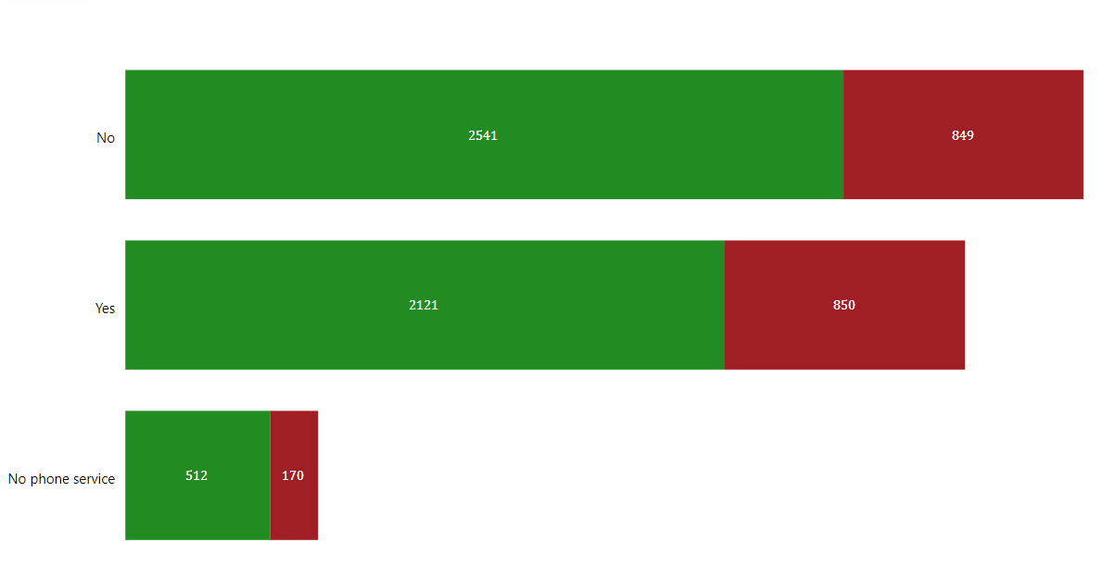
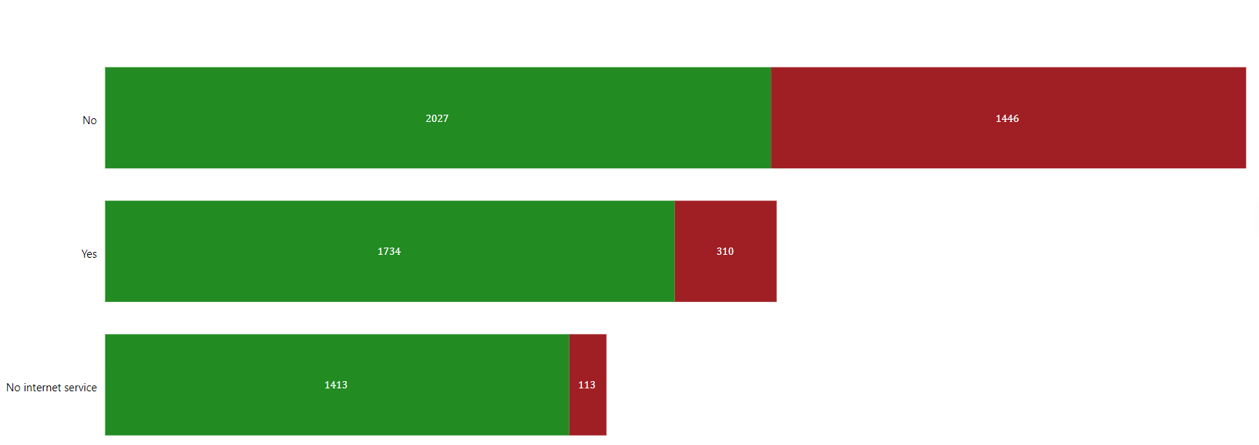
Streaming Services (Movies and TV): Customers who subscribe to streaming services are generally more satisfied and loyal.
Multiple Lines: Having multiple lines is associated with higher churn, possibly due to complexity or higher costs.
Tech Support: Access to tech support services significantly reduces churn, as customers appreciate the help they receive with technical issues.
TV
MOVIE
MULTI LINE
TECH SUPPORT

Slide 13
RECOMMENDATIONS
1. Focus on Retention Programs for New Customers: Develop engaging strategies for new customers, especially within their first year, to make them feel valued and reduce early churn.
2. Promote Long-term Contracts: Encourage customers to switch to one-year or two-year contracts through attractive promotions or discounts, fostering a sense of stability and commitment.
3. Improve Fiber Optic Service Quality: Address any issues related to Fiber Optic services to meet customer expectations and reduce dissatisfaction.
4. Enhance Payment Experience: Simplify the payment process and offer incentives for using methods with lower churn rates, such as credit cards and bank transfers.
5. Expand Service Offerings: Promote additional services like online backup, security, and streaming to enhance customer satisfaction and retention.
6. Personalized Support: Provide personalized support and tech assistance to increase customer satisfaction and foster loyalty.
CONCLUSION
My journey through the customer churn data has revealed valuable insights into the factors driving customer loyalty and attrition. By understanding these patterns, we can develop targeted strategies to reduce churn and enhance customer satisfaction, ultimately leading to a more robust and successful business.
DATA SOURCE
LIVE DASHBOARD

